Slide 1

Capstone Project
on Airbnb Booking Analysis By-Pratik Shiralkar

Slide 2
KEY POINTS FOR UNDERSTANDING
Summary
Neighborhood Groups
Neighborhood
Room Type
Price
Availability Of Rooms
Number Of Reviews
Correlations
Conclusion

Slide 3
SUMMARY
nyc_df- It all contains details about the dataset.
info_nyc_df- It contains statistical details about the dataset.
features_nyc_df- It contains all featured columns in the dataset.
unique_values_nyc_df- It contains all unique values of the column features.
room_type_nyc_df- It contains all room types appeared in the dataset.
neighbourhood_groups_nyc_df- It contains all neighborhood groups available in dataset.
prices_nyc_df- It contains all statistical details about the price appeared in the dataset
df- It contains information about price distribution.
top_host_nyc_df- it contains all top host id’s.
neighbourhood_group_nyc_df- It contains prices in neighborhood groups.
neighbourhood_prices_nyc_df- It contains prices in neighborhood .
top_host_id_with_reviews_df- It contains information about top host id with reviews.
price_with_room_availability_nyc_df- It contains information about price with room availability .
corr_nyc_df- It contains information about correlation between features.

Slide 4
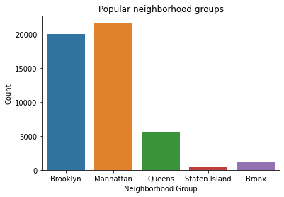
POPULAR NEIGHBORHOOD GROUPS
From the popular neighborhood groups it is noticed that there are five neighborhood groups featured in the dataset .They are Brooklyn ,Manhattan ,Queens ,Staten Island and Bronx.
Manhattan is the most popular group among the groups, having most number of listings.
Brooklyn is having second most number of listing .
Queens and Bronx having less number of count .
Staten Island is having least number of counts.
.

Slide 5
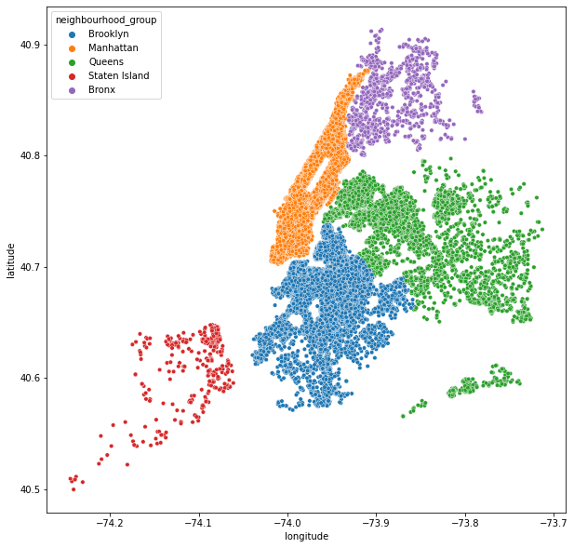
NEIGHBORHOOD GROUP WITH AREAS
Orange color showing for Manhattan group..
Brooklyn is shown in the Blue color.
Queens neighborhood group shown in green .
Staten Island neighborhood group shown in red .
Bronx neighborhood group shown in violet

Slide 6
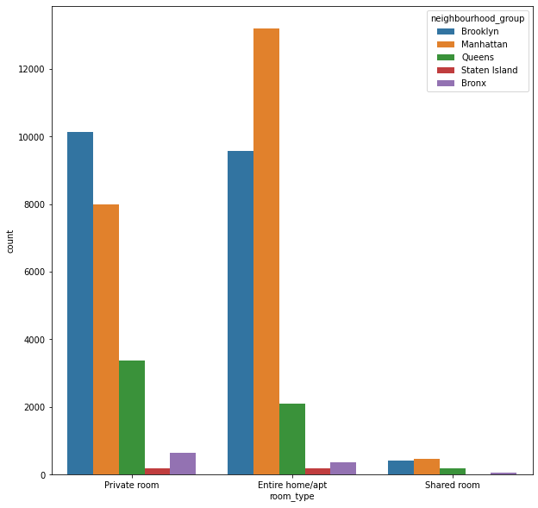
NEIGHBORHOOD GROUP WITH ROOM TYPE
For neighborhood group Brooklyn ,there are maximum number of counts private rooms followed by apartment room type then shared rooms.
For neighborhood group Manhattan ,there are maximum number of counts for Apartment rooms followed by private room type then shared rooms.
For neighborhood group Queens ,there are maximum number of counts private rooms followed by apartment room type then shared rooms.
For neighborhood group Staten Island ,there are similar number of counts private rooms and apartment room type then very less for shared rooms.
For neighborhood group Bronx ,there are maximum number of counts private rooms followed by apartment room type then shared rooms.

Slide 7
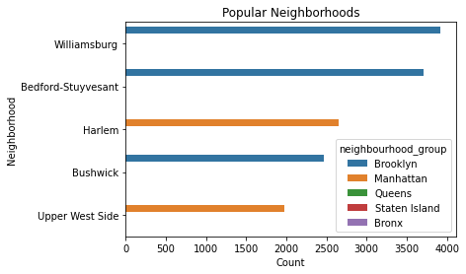
TOP NEIGHBORHOODS
Williamsburg is the top neighborhood among the other neighborhoods.
Bedford-Stuyvesant and Bushwick these top neighborhoods are from Brooklyn neighborhood group.
Harlem and Upper west side these top neighborhoods are from Manhattan neighborhood group.
All these top neighborhoods are from Brooklyn and Manhattan neighborhood groups.

Slide 8
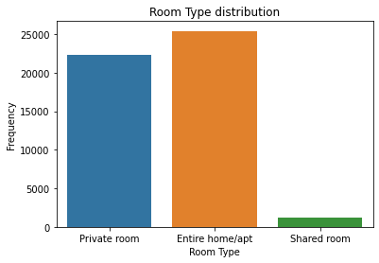
ROOM TYPE DISTRIBUTION
Entire home or Apartment Room Type distribution is most preferred type of room among the listings.
Private room type is second most preferred room type.
Shared room type is least type of rooms appeared .

Slide 9
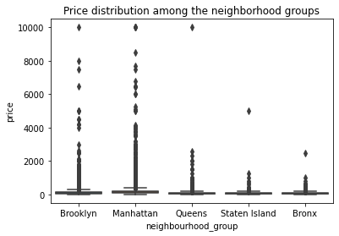
PRICE DISTRIBUTION AMONG NEIGHBORHOOD GROUPS
Price distribution among the neighborhood groups shows that Brooklyn and Manhattan have range of values from 0 to 10000.
Price distribution among the neighborhood groups shows that Queens, Staten Island and Bronx having range of values not big as compared to Brooklyn and Manhattan.
From plot it is seen that 75% values below 200 dollars .

Slide 10
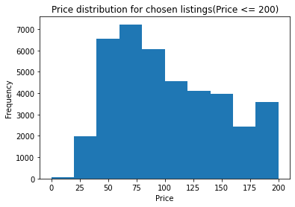
PRICE DISTRIBUTION
Price distribution for chosen listings which is having price range lower than 200 dollars.
Most of the chosen listings for price range between 50-100 dollars.
100-200 dollars also favoured price range for listings.
0-50 dollars having least favoured range of price.

Slide 11
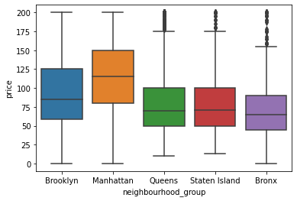
NEIGHBORHOOD GROUP PRICING
Price range is shown in this plot is between 0 – 200 dollars.
Manhattan is having maximum average price about 140 dollars.
Manhattan followed by Brooklyn is having average price about 90 dollars.
Queens ,Staten Island and Bronx having average price between 70-75 dollars.

Slide 12
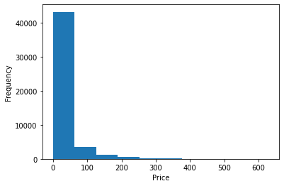
PRICE FREQUENCY
Plot is showing most preferred prices on the listing.
Price range between 0- 75 dollars, having highest frequency or count on the listings.
Price range after 75-200 dollars , having comparatively less frequency as compared earlier one.
Prices after 200 dollars are very much less chosen.

Slide 13
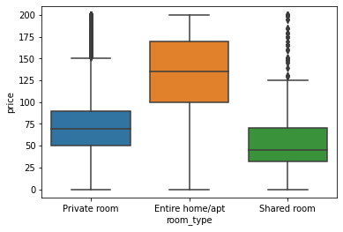
PRICES IN ROOM TYPES
Plot is showing Prices for room types.
Entire room or Apartment home type is having most prices for rooms lower than 200 dollars.
Apartment rooms having average price of 140 dollars.
Private rooms having average price of 90 dollars.
Shared rooms having average price of 40 dollars.

Slide 14
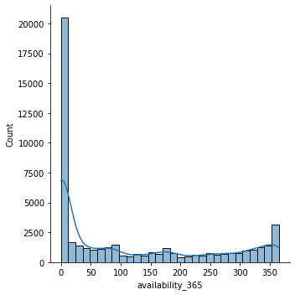
AVAILABILITY OF ROOMS
Plot is showing number of rooms available for 365 days .
Maximum number of listings available for 0 to 13 days.
Consistence availability of rooms are shown from 15 days a year to 350 days a year.
Availability of rooms for 365 days a year is also having a good numbers.

Slide 15
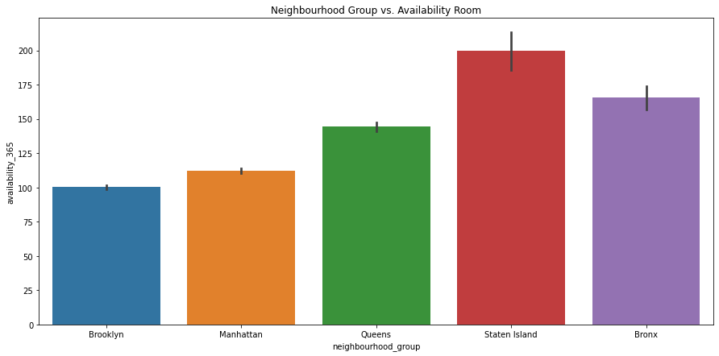
AVAILABILITY OF ROOMS IN NEIGHBOURHOOD GROUP
Staten Island having maximum number of available rooms in the neighborhood groups.
Bronx having second most available rooms in the neighborhood groups.
Queens and Manhattan are having less availability of rooms among the neighborhood groups.
Least rooms is available in the Brooklyn neighborhood group.

Slide 16
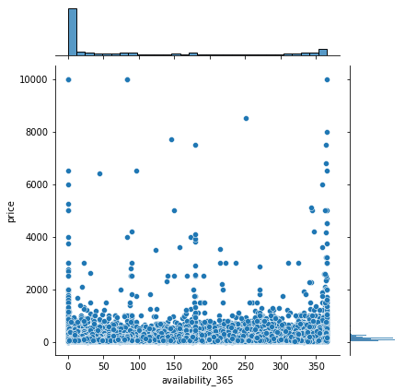
AVAILABILITY WITH PRICE
Plot shown here is about availability of rooms against price .
Basically from this information consistent availability of room for lower price.
For 1 or 2 day booking, there are rooms available with various price range.
For 365 days also booking available at various prices.

Slide 17
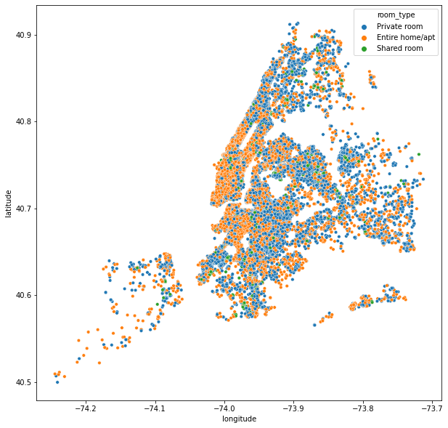
ROOM TYPES IN VARIOUS AREAS
Entire home or Apartment rooms are shown in orange color in this area. Maximum number of listings are occupied by these type of rooms.
Private rooms are shown by blue color dots. They are scattered through out the plot. These rooms are also having considerable large number of bookings.
Shared rooms shown in green dots. These rooms having comparatively less rooms on the listings.

Slide 18
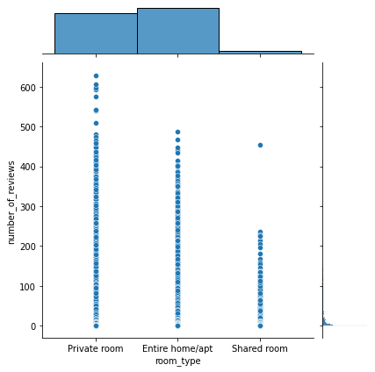
REVIEWS FOR DIFFERENT ROOM TYPES
Private rooms having maximum number of review for single room .more than 600 reviews obtained for single room.
Apartment rooms also having various range of value. It is having close to 500 reviews for single room .
Shared rooms having less number of reviews compared to other types of rooms, having max values for reviews is 250.

Slide 19
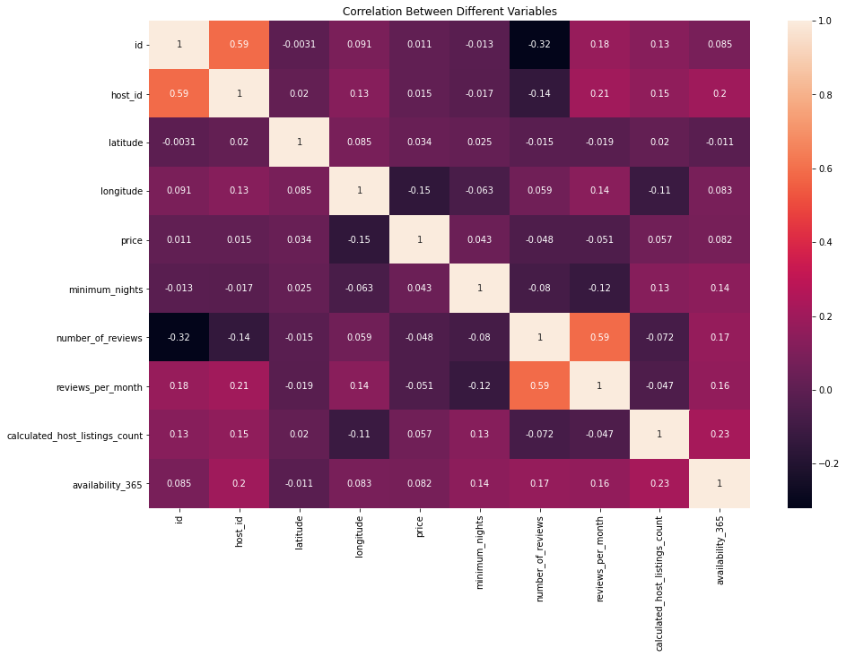
CORRELATIONS
Heat map showing correlations between different characteristics .
From the values obtained from heatmap we can say that there is no strong correlation between the features.

Slide 20
CONCLUSIONS-
Manhattan is the most popular group among the groups, having most number of listings.
For neighborhood group Brooklyn ,there are maximum number of counts private rooms and Shared rooms.
For neighborhood group Manhattan ,there are maximum number of counts Apartment rooms.
Williamsburg is the top neighborhood among the other neighborhoods.
All these top neighborhoods are from Brooklyn and Manhattan neighborhood groups.
Entire home or Apartment Room Type distribution is most preferred type of room among the listings.
Price distribution is having 75% values below 200 dollars.
Price range between 0- 75 dollars, having highest frequency or count on the listings.
Apartment rooms having average price of 140 dollars.
Maximum number of listings available for 0-13 days.
Staten Island having maximum number of available rooms in the neighborhood groups.
Private rooms having maximum number of review for single room.
From Heat map we can say that there is no strong correlation between the features.

Slide 21


